Slide 1

Slot 5: Quiz 1 Module 3
Classes and Objects

Slide 2
Learning Objectives
Describe the difference between classes and objects.
Develop an object-oriented console application to meet specific functional requirements.
Use C# and custom documentation to effectively utilize C# and custom C# code.

Slide 3
Content (slot 1)
Introduction to Classes and Objects
Your First C# Program Revisited
Calling Methods
Exercise 8
Exercise 9
Reference Types in Memory

Slide 4
Content (slot 2)
The Circle Problem Revisited
The Circle Problem in Unity Revisited
Putting It All Together in a Console App
Putting It All Together in a Unity Script
Common Mistakes

Slide 5
Introduction to Classes and Objects
The main idea behind the object-oriented paradigm is that our problem solutions consist of a set of collaborating objects.
These objects reflect all the objects we see around us in the real world.
Examples: furniture, cars, bank accounts, students, and bicycles.
An object has states, behaviors and identity.

Slide 6

Introduction to Classes and Objects
The state (field) of an object indicates what the object “looks like” at any given time.
Example: States of a Lotus Elise include its horsepower, speed, its current location, how many wheels (if any <grin>) are in contact with the road at the moment, and so on.
What is state of a book/ a playing card?

Slide 7
Introduction to Classes and Objects
C# provides an easy way to access an object's state through properties.
Example: For the Lotus Elise, we need to know its location (and other information) to check if it's colliding with something in our game.
Methods specify an object's behavior.
Example: we want to be able to open or close the book, to change the page in the book, and to look at the current page. For the card object, we’ll want to be able to flip the card over, so we’d need the card object to do that for us.
Identity distinguish one object from others.

Slide 8
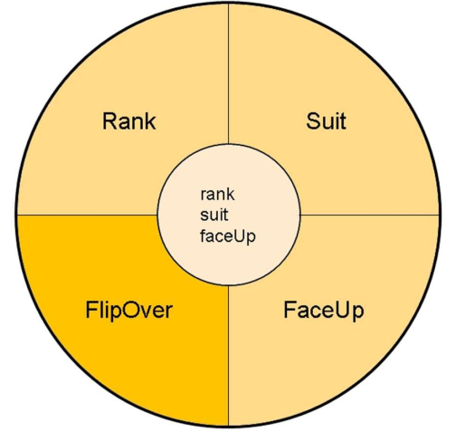
Introduction to Classes and Objects
states/ fields (lightest color)
properties (medium color)
methods (darkest color)

Slide 9
Introduction to Classes and Objects
Encapsulation is the process of combining related fields and behaviors into a single object, essentially placing them all in a single “capsule.”
Information hiding means that the fields of an object are “hidden behind the wall of properties and methods” for the object.
instantiation used to create a new object (instance) from the class.
In C# the fields, properties, and methods of a class are called the class members.
Important Unity Note: There are lots of classes in Unity that actually do expose the fields of objects rather than using properties to control access to those fields. We'll obviously access those fields when we need them without feeling any guilt whatsoever, but when we design our own Unity scripts (which are classes) we'll use properties whenever we can.

Slide 10
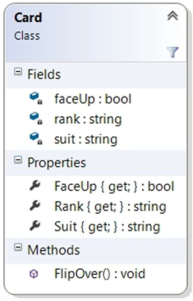
Introduction to Classes and Objects
UML representation of playing card class.

Slide 11
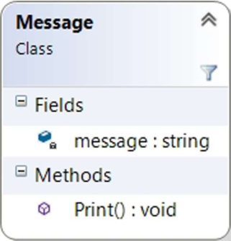
Your First C# Program Revisited
UML for Message Class
No property
The Print method definitely needs access to message field.

Slide 12
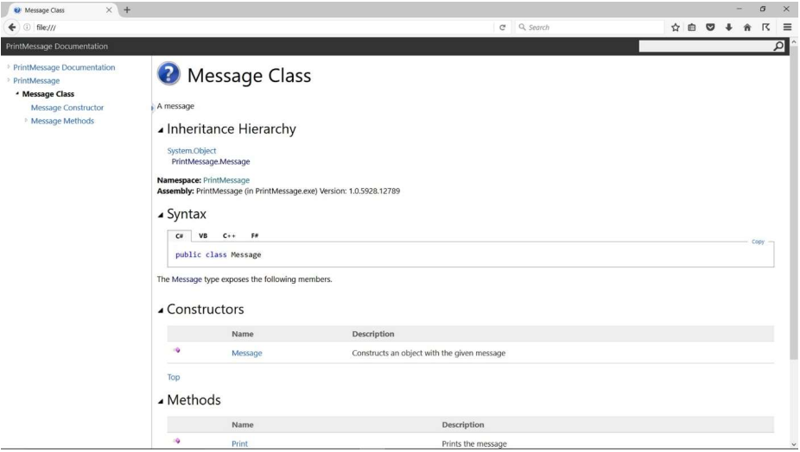
Your First C# Program Revisited
Message class document.

Slide 13
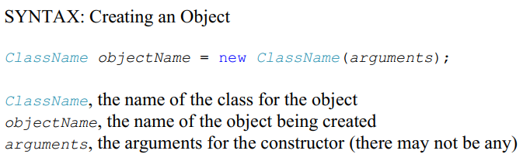
Your First C# Program Revisited
To create a tiny message that says Hi!, we'd use:

Slide 14
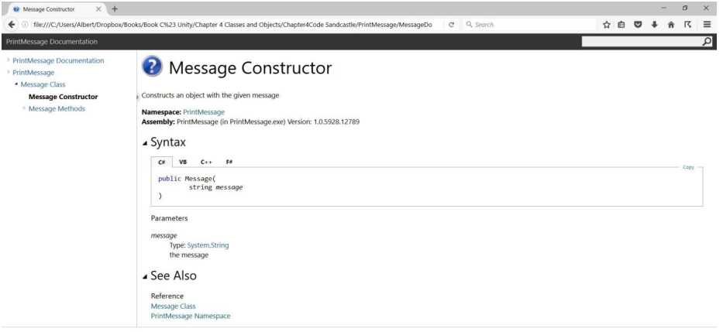
Your First C# Program Revisited
To know that the constructor requires one argument for the message string, we click on the Message constructor link in the documentation.

Slide 15

Your First C# Program Revisited
Creating a message object for a message has several lines:
escape sequence:
\n
Newline. The cursor is moved to the next line on the screen
\t Tab. The cursor moves to the next tab stop on the screen
\r Carriage return. Moves the cursor back to the beginning of the current line
\\ Backslash. Prints a backslash. We can't just include a single backslash, because a single backslash is interpreted as the escape character
\" Double quote. Prints a double quote. We can't just include a double quote in our string, because a double quote is interpreted as the end of the string.

Slide 16

Your First C# Program Revisited
Objects that have been declared as variables but haven't been created yet are initialized to a special value, null.
We can't use any of the object's methods or do anything else particularly useful with the object until we create it.
Example:
The compiler will complain to you that rainMessage was never initialized.

Slide 17
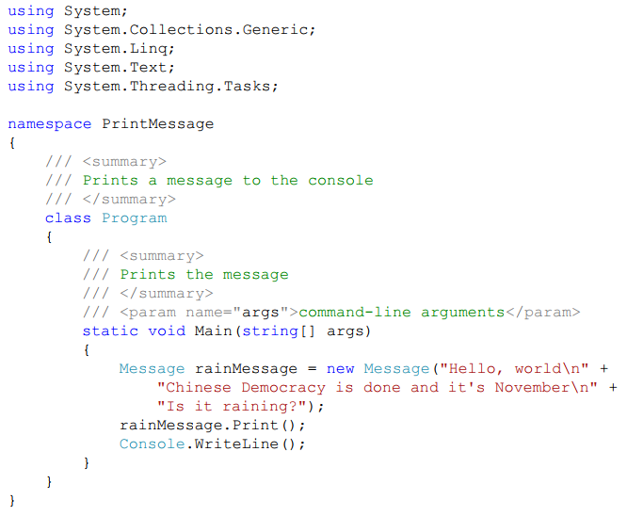
Your First C# Program Revisited

Slide 18
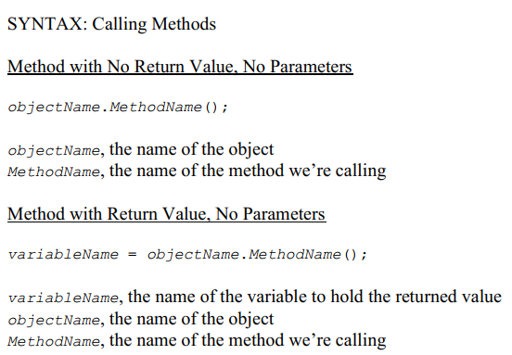
Calling Methods

Slide 19
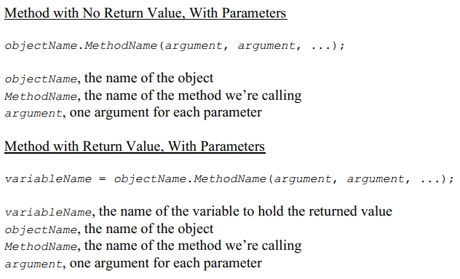
Calling Methods

Slide 20
Calling Methods
Parameters are the things included in the method header
At this point, we learn about a method’s parameters by reading the documentation for the method.
Arguments are the things we include in a method call to “match up with” the parameters for the method we’re calling.
Ex:
Calling a method that doesn't return a value and doesn't have any arguments:
Calling a method that returns a value but still doesn't have any parameters:

Slide 21

Calling Methods
Ex:
Calling a method that has arguments but doesn't return a value:
Or
Calling a method that has arguments and return a value:

Slide 22
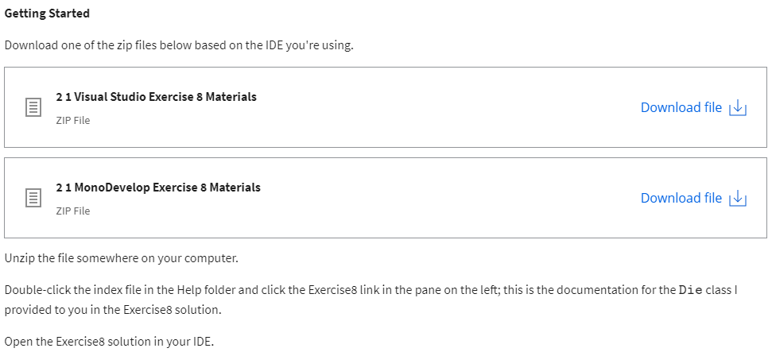
Exercise 8: Rolling the Dice

Slide 23
Exercise 8: Rolling the Dice
Problem 1 - Create two dice
Declare die1 and die2 variables and use the appropriate Die constructor to put new six-sided Die objects into those variables.
Use the help documentation I provided to figure out which constructor to use.
Problem 2 - Tell the dice to roll themselves
Tell the die1 and die2 variables to roll themselves. Use the help documentation I provided to figure out which method to use.
Side note: The solution I gave you includes a RandomNumberGenerator class that's initialized in the Main method and used by the Die class when a die rolls itself. It's pretty common to have a random number generator that's used by the whole "game".
Problem 3 - Print the top sides of the two dice and print their sum
Print the top sides of the two dice. Use the help documentation I provided to figure out which property to use.
Print the sum of the top sides of the two dice.
Hint: It's easiest to declare a variable that holds the sum of the top sides of the two dice, then print that sum.

Slide 24
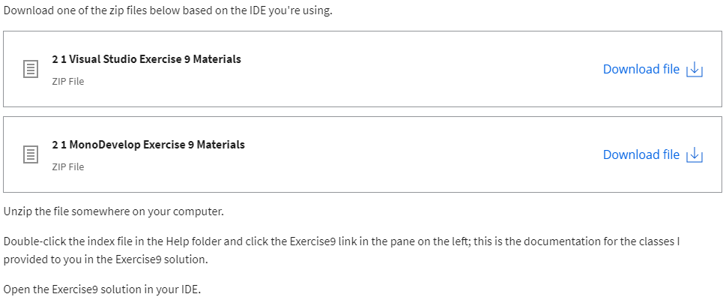
Exercise 9: Look at the Cards

Slide 25
Exercise 9: Look at the Cards
Problem 1 - Create a deck and tell it to print itself
Declare a deck variable and use the Deck constructor to put a new Deck object into the deck variable.
Tell the deck to print itself. Use the help documentation I provided to figure out which method to use.
Note: The deck prints itself from bottom to top, so the last card listed is at the top of the deck.
Problem 2 - Tell the deck to shuffle and print itself
Tell the deck to shuffle itself and print itself. Use the help documentation I provided to figure out which methods to use.
Problem 3 - Take two cards from the deck and print their ranks and suits
Take a card from the top of the deck and print its rank and suit. Use the help documentation I provided to figure out which Deck method to use to get the top card and which Card properties to use to print the rank and suit.
Take another card from the top of the deck and print its rank and suit.
Hint 1: The Card class doesn't expose a Print method, so you have to access a card's properties to print the required information.
Hint 2: You haven't called a method that returns a value yet. Here's a good way to do that for this exercise:
Card card0=deck.TakeTopCard();
The DeckTakeTopCard method returns a Card object. You need to save that object in a variable so you can access its properties.

Slide 26
Reference Types in Memory
Reference types are called that because variables that are reference types refer to an object that's been created in memory.
The data type for an object is a class which are also called reference data types in C#.
The value of a reference type variable is the memory address of the actual object in memory.

Slide 27
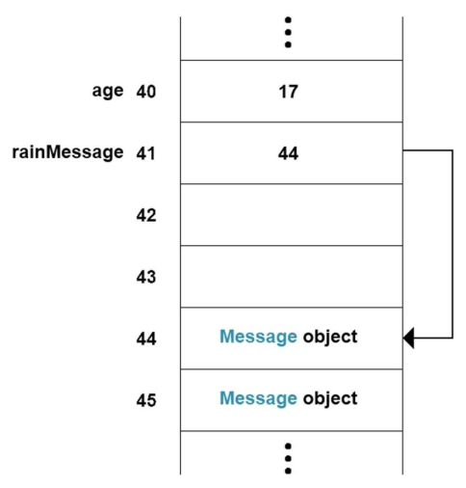
Reference Types in Memory
Value and Reference
Type Example

